Slide 1
Dis-enchantment, or: There is no magic, only engineering
[deconstructing nouveau tech, for petro tech]
DIRECTOR’S CUT

Slide 2
There is no royal road to geometry.
–Euclid
…I don't believe in the idea that there are a few peculiar people capable of understanding math and the rest of the world is normal. Math is a human discovery, and it's no more complicated than humans can understand. I had a calculus book once that said, “What one fool can do, another fool can.”
–Richard Feynman
These forty years now I’ve been speaking in prose without knowing it!
–Molière, The Bourgeois Gentleman

Slide 3
Thesis
If you want to learn data science, machine learning, AI, or any other modern tech buzzword, the path starts with programming
If you’re in a petro tech profession, you are probably already a programmer, and you’re certainly well equipped to learn
Learn programming like any other engineering skill: from the fundamentals

Slide 4
Outline
Why programming?
There is no magic, only engineering
Seeing like an engineer
Case Study I: data science requires programming
Case Study II: leading from the front with automation
Case Study III: domain-specific languages for engineering problems
Q&A

Slide 5
Explain machine learning to Socrates

Slide 6
Explain machine learning to Socrates

Slide 7
There is no magic, only engineering
It’s OK to feel like a wizard, though

Slide 8
You’re a wizard, Harry

Slide 9
You’re a wizard, Harry

Slide 10
You’re a wizard, Harry

Slide 11
You’re a wizard, Harry
“For hanigen with hunigen still haunt ahunt to finnd their hinnigen where Pappappapparrassannuaragheallachnatullaghmonganmacmacmacwhackfalltherdebblenonthedubblandaddydoodled and anruly person creeked a jest.” –James Joyce, Finnegans Wake

Slide 12
You’re a wizard, Harry
wow
such functional programming
very co-recursive streams
much reactive dataflow

Slide 13
Programming is an engineering discipline
Solve concrete problems
Under constraints
By applying quantitative techniques and knowledge of “first principles”
There’s also plenty of room for creativity

Slide 14
The abstraction tower
Mechanical Engineering
Programming
Modules
Programs
Gears
Trusses
Functions
Classes
Data Structures
Alloys
Linkages
Materials
Instructions
Memory
Values
Atoms
Forces
Transistors
Bits

Slide 15
Computing as she is spoke

Slide 16
Computing as she is spoke
Marketese | English
server | computer
cloud computing | rented computer
edge computing | outdoor computer
Internet of things (IoT) | computer in your toaster
big data | didn’t fit in memory on my computer
blockchain | slow database for paranoiacs
NoSQL | slow, unreliable database
machine learning | curve fitting on a computer
artificial intelligence | computer program
deep learning | curve fitting with lots of matrix multiplication
data science | using a computer

Slide 17
How to get started
There are a ton of free intro programming courses in various languages (see my links at the end)
There’s a real shortage of “next step” courses, but we’re working on that
The most important thing is to WRITE LOTS OF CODE
The second most important thing is to READ LOTS OF CODE
The least important thing is getting everything right the first time: remember Wittgenstein’s ladder
“My propositions serve as elucidations in the following way: anyone who understands me eventually recognizes them as nonsensical, when he has used them—as steps—to climb beyond them. (He must, so to speak, throw away the ladder after he has climbed up it.)”
–Ludwig Wittgenstein, Tractatus Logico-Philosophicus

Slide 18
Seeing like an engineer
All models are wrong, but having no model is worse

Slide 19
The Python “abstract machine”
A
Infinite association mapping names (variables) to values (objects)
Values have types (really, “classes”)
The name-to-value association is mutable: we can freely rebind variables (even to values of different types)
Programs are sequences of statements
Statements execute one-at-a-time, and may contain control structures and expressions
Control structures alter execution
Expressions combine values to produce new values

Slide 20
A Python “abstract machine”
Evaluation!
x = 3
x = x + 1
+
1
4
x
Coo!
Coo?
3

Slide 21
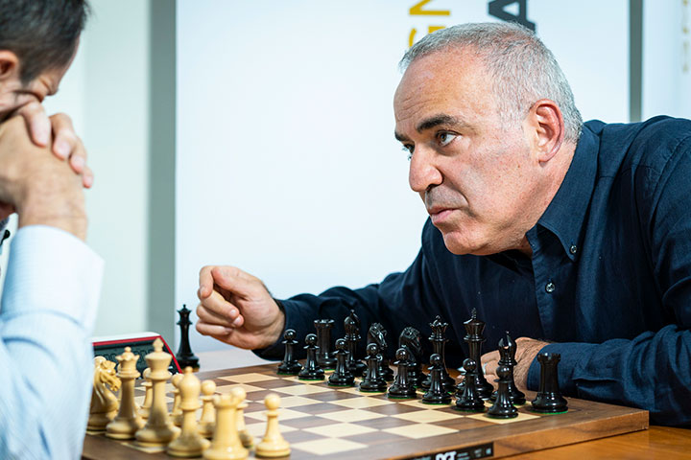
Games for computers, games for humans
Games for Computers
Games for Humans
Simple behavior rules
Small, enumerable state space
Deterministic
Complex dynamic behavior
Huge state space
Non-deterministic
Adversarial

Slide 22
Program checking, a game for computers
def trapezoidal(f, x_1, x_2, steps=10):
step = (x_2 - x_1) / steps
x = x_1
sum = 0.0
for _ in range(steps):
sum += step * 0.5 * (f(x_1) + f(x_2))
return sum
print(trapezoidal(lambda x: x * x, 0, 10))
> 500.0
print(trapezoidal('potato', True))
> Traceback (most recent call last):
File "<stdin>", line 1, in <module>
TypeError: trapezoidal() missing 1 required positional argument: 'x_2'

Slide 23
Program checking, a game for computers
def trapezoidal(f: Callable[[float], float], x_1: float, x_2: float, steps: int = 10) -> float:
step = (x_2 - x_1) / steps
x = x_1
sum = 0.0
for _ in range(steps):
sum += step * 0.5 * (f(x_1) + f(x_2))
return sum
print(trapezoidal(lambda x: x * x, 0, 10))
mypy> Success: no issues found in 1 source file
print(trapezoidal('potato', True))
mypy> trape.py:11: error: Too few arguments for "trapezoidal"
mypy> trape.py:11: error: Argument 1 to "trapezoidal" has incompatible type "str"; expected "Callable[[float], float]"

Slide 24
Case Study I: The Hard Part of Data Science
… is manipulating the data

Slide 25
The ancient world of 2015 AD
Before the Shalepocalypse…
Client: independent E&P (they’ve since been acquired)
Problem: managing an unconventional oil basin
Use predictive models to think on the margins:
Cut a lot of completion cost for little loss of productivity?
Increase productivity in underperforming areas?
Identify low-cost, high-benefit interventions
More accurately value acreage
Small, weird data: 108 completions with production, completion, petrophysical data

Slide 26
Cluster analysis
Why?
Avoid Simpson’s paradox
Framework for understanding geologic contribution
Quantify interactions between reservoir, completion, production
How?
K-means clustering
Assign wells to groups based on statistical similarity in geologic, completions parameters

Slide 27
Cluster analysis
Identified 4 distinct groups
#1: the great stuff
#2: the rest
#3: the good stuff
#4: big fracs

Slide 28
Cluster overview: PCA

Slide 29
Cluster overview: PCA

Slide 30
Questions & next steps
No group shows a very strong relationship between completion design and performance—why?
The “good stuff” cluster demonstrates performance almost totally invariant to frac design—why?
The analysis thus far hasn’t touched on well spacing. Does this moderate or mediate the relationship between completion size and performance?

Slide 31
Ugh, we have to program: adding frac data
“Digitized” all available frac reports
Extracted stage-by-stage log-log net pressure vs time, BH proppant, and slurry rate curves
Truncated net pressure curve to proppant-on-bottom time
Applied segmentation to break net pressure data into roughly linear chunks
Assessed each chunk as positive, neutral, or negative slope
Tabulated % of time in each regime as well as transitions between regimes

Slide 32
The frac analysis pipeline
PDF Frac Reports
Provided by service company
Pressure trend extractor
Python script
Pressure trend segmentor
Julia script
Lots of graphs
Extract SVG graphics from PDF
Parse SVG graphics, using styles to detect relevant lines
“Re-quantify” lines to numerical data series
Apply dynamic programming algorithm to identify best linear segmentation of data series
Export segment information
ML model
R scripts
Transform line segments into discrete slope (+, -, neutral) indicators
Incorporate new features into existing ML model
No tables ☹
“The Programmer’s Credo: we do these things not because they are easy, but because we thought they were going to be easy.”
–Maciej Cegłowski

Slide 33
Linear segmentation

Slide 34
Controlling for well spacing
Quantified “well spacing” by calculating observed density of completions in X, Y, Z space

Slide 35
Controlling for well spacing and order
Small direct correlation from well density to performance, but consider density vs. frac order vs. performance
Well density < 0.03: minimal correlation of (local) frac order to (remaining variance in) performance
Well density >= 0.03: striking negative correlation of order to performance

Slide 36
Combined model
Final correlation: geology + frac + spacing = performance
Explains about 60% of total variance in performance
We still underpredict some of our very best completions
Why? (but that’s a story for another time)

Slide 37
Case Study II: Easy Wins with Excel VBA
Quick & Dirty Workflow Optimization for Engineers-turned-Leaders

Slide 38
Congratulations! You’re a manager!
Your hard work paid off!
All those extra hours and long nights were worth it! (What personal life?)
You are now a glamourous leader!
People listen to you! (dance, puppets)

Slide 39
Now you get to deal with all this stuff!
Legal holds & data management
Holding teams accountable to manual work processes
Weird personal issues & unrequested photos of said personal issues
“I can’t find Word on my desktop because I deleted it.”
“I can’t find the internet. Let me try rebooting my computer.”
“I won’t be in today, my goldfish died. And I may have COVID – from 3 weeks ago. This is also the same time as some sporting event. Don’t think about it too hard and you can’t say anything about me taking sick time.”
This is because of legal reasons. Start getting used to hearing about “legal reasons” every 30 seconds from HR. And your boss. And the cops.

Slide 40
Some background…
Manager in petrochemical industry for 5 years over several workgroups and two companies.
Some small groups, some large, some contractors, some union.
Enjoy programming as a hobby to keep my technical skills up. It’s now part of my job.
Across all these groups, I’ve noticed people getting bogged down in workflows or menial tasks.
Most of these can be automated using simple tools, with Python or VBA, and make everyone’s lives 1000x’s easier.
Some quick caveats – use documentation from the language creator. Don’t use shady sites like, “HackExcel in 6 easy steps! Step 1: install Excel.” A lot of these sites don’t understand how Excel functions work and take the long road to do simple tasks. These often break and don’t do what you think it does.
(I do sometimes use these sites to get ideas or to see the language syntax.)
Simple is often best.
I’ve inherited many VBA Macros from engineers.

Slide 41
Example 1: Time Savers – Folder & Form creation.
The department tracks changes to the chemical plant through a Management-of-Change system. (This is an OSHA thing in hazardous chemical refining.)
Besides an intranet log of the scope of the change and the change approvers, we needed a system to keep documents associated with the change.
Documents need to be stored on the server for easy editing during change review. Forms need to be generated for tracking reasons.
Staff manually created ~ 40 MOCs a month. Each generic folder & file creation took 15-30 min.
This was easily automated and saved the department a lot of headache.

Slide 42
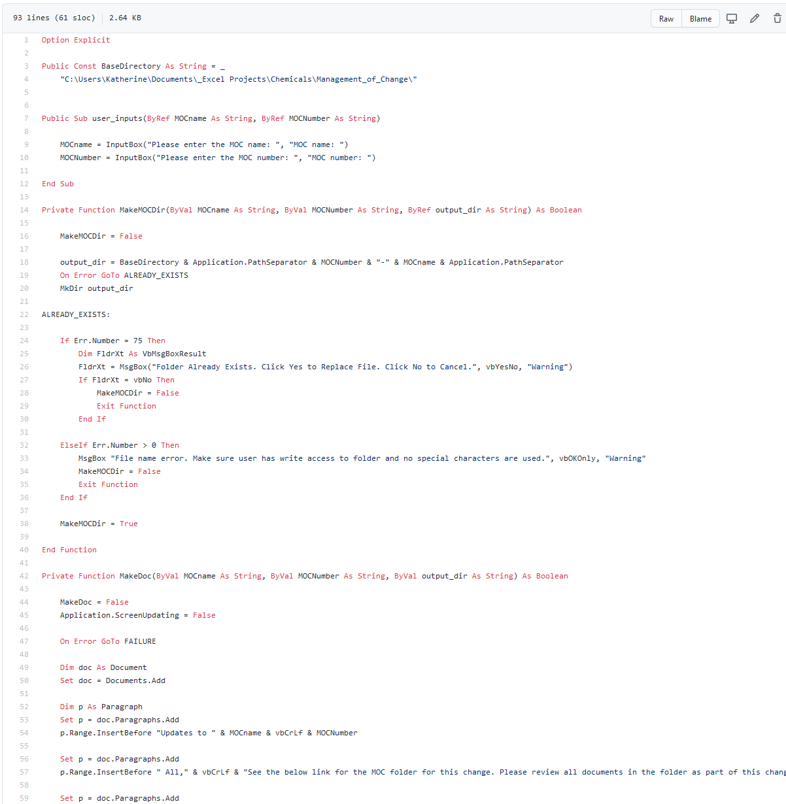
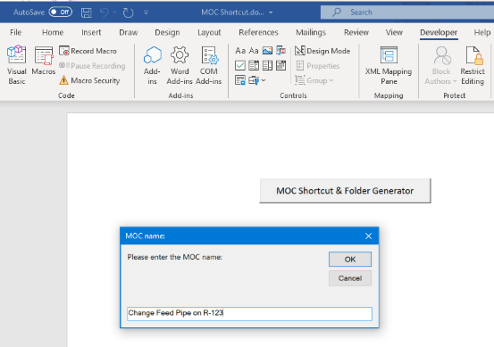
Folder generator
100 lines of code
Took a Saturday with a few beers
Easy to use. Saved countless hours for department.

Slide 43
This can easily be modified to meet other needs
Does your group make a lot of redundant files or folders on a server?
Could it be automated?
Consider making a pop-up form to generate the files and folders.
GitHub code (https://github.com/kbturk/OfficeVBA_Folder_Generator/blob/master/Generator.Bas)

Slide 44
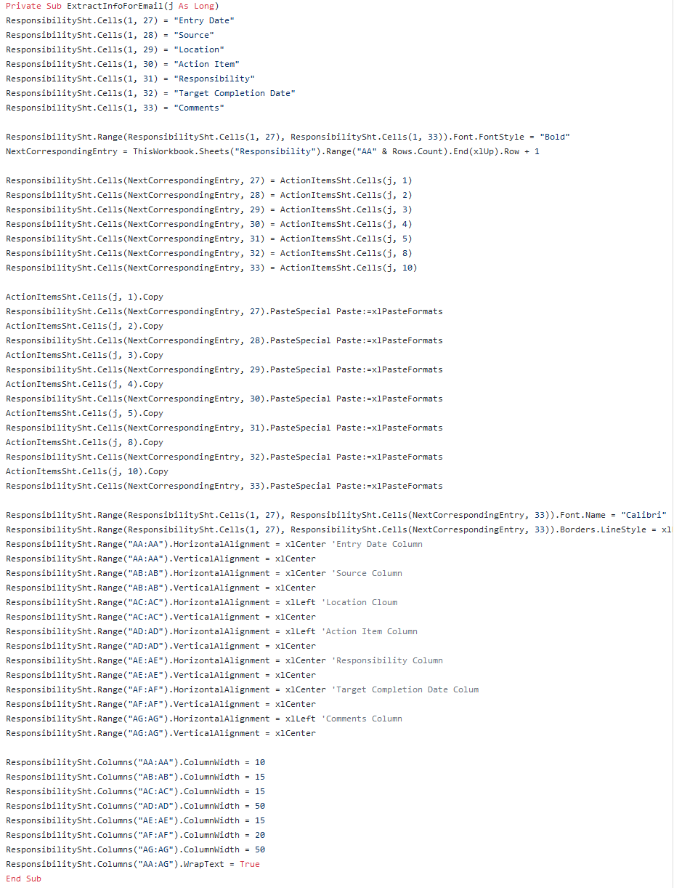
Example 2: Excel “database” macro speedup
Department maintains an Excel “database” of action items across teams. One person sends monthly reminders of upcoming action items & drives accountability.
Common in industry.
However, at least 4 engineers had owned the database and added code to automate simple tasks.
Lots of VBA recordings and VBA code found on shady “become an office ninja” sites.
This behemoth took 15 minutes to open and would frequently crash.
Solution: met with database owner, simplified what we really needed the workbook to do, and cleaned out the code. Replaced iteration code with functions in VBA from Microsoft documentation.
The spreadsheet went from 500 lines of code to about 10 active lines. The workbook opened in <30 seconds and still had all the functionality it needed to.

Slide 45
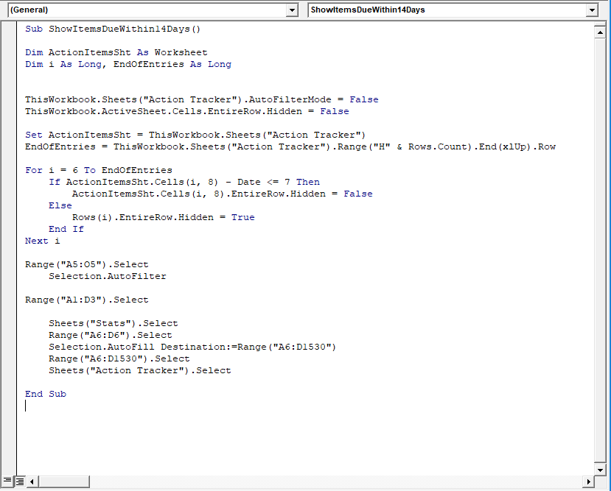
Old code to new code rewrite
AutoFilter is a built in excel VBA function
Date is a built-in function
This code was hanging on the iterator function and the EndOfEntries variable wasn’t always setting to the right cell.
The code this was found on a Hack Excel aka Code Ninja site.

Slide 46
Don’t be afraid to delete old code
Export the .bas file from VBA then go to town.
Write out what the program needs to do.
Use source documents when possible.
Initially this can be challenging, but in the long run your code is more likely to be stable and work after you’re gone.
You’ll also get a better understanding for how VBA works.

Slide 47
Example 3: VBA emails
Excel based forms and automatic emails can be useful to departments in several ways.
These can be used to send reminders or updates.
They can be used to issue and track approvals for projects or overtime.
They can write to a locked spreadsheet to track when approval requests were submitted and granted.

Slide 48
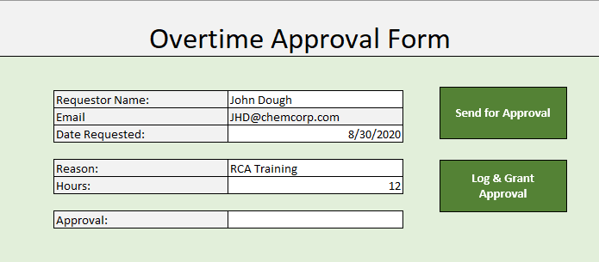
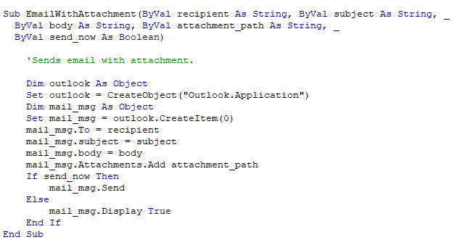
Overtime approval
Staff fills out a form
Auto generates an email for approval
When approval is granted,
logs into a locked spreadsheet.
Send email back to requestor
that overtime is approved.

Slide 49
Takeaways
Automate repetitive tasks for the department. It saves everyone time to do more interesting work.
Source material is your friend. Take the time to understand how built in functions work.
Don’t be afraid to delete old code.

Slide 50
Case Study III: Found in Translation
Domain-Specific Languages for Simple, Composable Systems

Slide 51
A recurring problem
We have experts in some topic or “domain” whose jobs can be made easier with software
So we build the software
They love it!
And then: “well, in situation X, model A doesn’t really apply… unless condition Y”
“Can you add an option for that?”
So we do

Slide 52
The lifecycle of “configurable” systems
New, “elegant” system
“We don’t need all that cruft…”
Mature, “flexible” system
“Can you add an option for that?”

Slide 53
Simple > Complex
Simple
Complex
“There are two ways of constructing a software design: One way is to make it so simple that there are obviously no deficiencies, and the other way is to make it so complicated that there are no obvious deficiencies. The first method is far more difficult.”
–C.A.R. Hoare, 1980 Turing Award lecture

Slide 54
Composable > Monolithic
Composable
Not composable (“monolithic”)

Slide 55
Notation Is A Technology
MMXVII
MCMLXXXVIII
= ???
2017
1988
= ???

Slide 56
Notation Is A Technology
MMXVII
MCCCCCCCCCLXXXVIII
= ???
2017
1988
= ???

Slide 57
Notation Is A Technology
M
CCCCCCCCCLXXI
= ???
2017
1988
= ???

Slide 58
Notation Is A Technology
CCCCCCCCCLXXXXIIIIIIIIII
CCCCCCCCCLXXI
= ???
2017
1988
= ???

Slide 59
Notation Is A Technology
= XXIIIIIIIII
2017
1988
= ???

Slide 60
Notation Is A Technology
= XXIX
2017
1988
= ???

Slide 61
Notation Is A Technology
1
= XXIX
2007
1988
= 9

Slide 62
Notation Is A Technology
1
1
= XXIX
1007
1988
= 9

Slide 63
Notation Is A Technology
1
1
= XXIX
1907
1988
= 29

Slide 64
Notation Is A Technology
= XXIX
= 29

Slide 65
Domain-specific languages
Let users express their problems in their vocabulary
Give them simple, composable parts (“words”)
And let them build up larger systems “in their own words”
It’s on us to figure out how to turn these domain-specific programs into efficient “solutions”
That is: parsing, interpreting or compiling, executing

Slide 66
CSS (cascading style sheets) the domain: formatting web documents
body {
background: white;
color: black;
font-family: "Gill Sans", "Gill Sans MT", "Cabin", sans-serif;
}
.footer {
text-align: center;
clear: both;
font-family: "Jura", sans-serif;
padding-top: 50px;
}
.footer h6 {
font-size: medium;
}

Slide 67
INFORM 7 the domain: text adventure games
To destroy (item - a person):
if the item is the player:
say "That turns out to have been a humongous mistake.";
end the game in death;
clear connections to the item;
let context be the holder of the item;
move corpse to context;
obliterate the item.
To destroy (item - a thing):
clear connections to the item;
let context be the holder of the item;
if the item is visible and something underlies the item:
say "[line break]Left behind [is-are list of things which underlie the item].";
now every thing which underlies the item is in the context;
obliterate the item.
from Damnatio Memoriae by Emily Short

Slide 68
STAN modeling language domain: Bayesian inference by Hamiltonian Monte Carlo
data {
int<lower=0> J; // number of schools
real y[J]; // estimated treatment effects
real<lower=0> sigma[J]; // s.e.’s of effect estimates
}
parameters {
real mu; // population mean
real<lower=0> tau; // population sd
vector[J] eta; // school-level errors
}
transformed parameters {
vector[J] theta; // school effects
theta <- mu + tau*eta;
}
model {
eta ~ normal(0, 1);
y ~ normal(theta, sigma);
}
from Bayesian Data Analysis, by Gelman et al.

Slide 69
Case Study: PML Portfolio Model Language
An independent E&P client built a sophisticated set of teams, processes, and technology for modeling, managing, and optimizing the corporate portfolio
Fully probabilistic characterizations of available opportunities: timing, dependencies, cashflows
Optimized for expected NPV under constraint and environment “scenarios”
See SPE-187162-MS

Slide 70
Case Study: PML Portfolio Model Language
We’d also built a high-performance post-processor for Monte Carlo simulation
Run the “optimized” selections under many probabilistic realizations (based on modeled uncertainty)
Report mean, P90, P50, P10 for each cashflow item (e.g. total capital, gross oil…)

Slide 71
Case Study: PML Portfolio Model Language
This worked well, but interesting questions look less like
“what’s the P90 total oil production in 2018 for the Permian?”
and more like
“what’s the probability of achieving our cashflow targets, while also staying within the desired capital budget?”
In fact, there are an infinite number of these interesting questions… and the programmer is the worst person of all to try to guess them up front.

Slide 72
Case Study: PML Portfolio Model Language
My solution: a simple expression language for describing how to aggregate and summarize cashflows and collect statistics from them
It allows arithmetic operations, discounting and rate-of-return calculations, cumulation over time, and simple logical comparisons (e.g. “does this value exceed this threshold?”)
Minimalist syntax (s-expressions) based on Lisp
Composable: operators nest in the expected way (“cumulative of total of NPV of difference of …”)
Trivially type-safe: everything’s a number
Easy to parse: prefix notation and (lisp style forms) remove ambiguity from the grammar (no PEMDAS hacks)

Slide 73
Case Study: PML Portfolio Model Language
(statistics
(summary (by-attribute [Region]) each-year
(total [Wells Per Year])
(total [Net BOE Volume Mboe])
(total [Net Lifting LOE M$])
(total (+ [Net Capital M$]
[Net ITS M$]
[Net Capitalized OH M$]
[Net Leasehold M$]
[Net Seismic M$]))
as [Net Total Capital M$]
(total [Net ATCF 0 M$])
(cumulative (total (discount 0.10 [Net ATCF 0 M$])))
as [Cumulative Net ATCF 10 M$]
)
mean
(percentile 90)
(percentile 50)
(percentile 10)
)
First, we replicated existing (static reports) functionality in PML…

Slide 74
Case Study: PML Portfolio Model Language
(statistics
(summary all-groups all-times
(and
(>= (total [Net ATCF 0 M$])
(average (* { 5 7 9 10 15 7 5 } 1000000)))
(>= (total [Net Oil Volume Mbbls])
1000000))
)
mean
standard-deviation
(percentile 90)
(percentile 50)
(percentile 10)
)
… but then we started building tools for ad-hoc investigations and “probability of achievement” queries.

Slide 75
Case Study: PML Portfolio Model Language
name ::= [string]
bin-op ::= - | / | < | <= | > | >=
var-op ::= + | * | and | or
time-metric ::= year | month | time
metric ::= number
| { number… }
| name
| time-metric
| (discount number metric)
| (bin-op metric metric)
| (var-op metric…)
| (in-year integer metric)
summary-fn ::= total | average | irr
summary-metric ::= number
| (summary-fn metric)
| (cumulative summary-metric)
| (bin-op summary-metric summary-metric)
| (var-op summary-metric…)
…
summary ::= (summary group-spec time-spec summary-metric…)
…
stats ::= (statistics summary stats-metric…)

Slide 76
Language processing is tree manipulation
Concrete Syntax
Abstract Syntax Tree
(/
(discount 0.10
[Net ATCF])
[Gross Oil])

Slide 77
Who needs syntax errors?

Slide 78
Q&A bingo

Slide 79
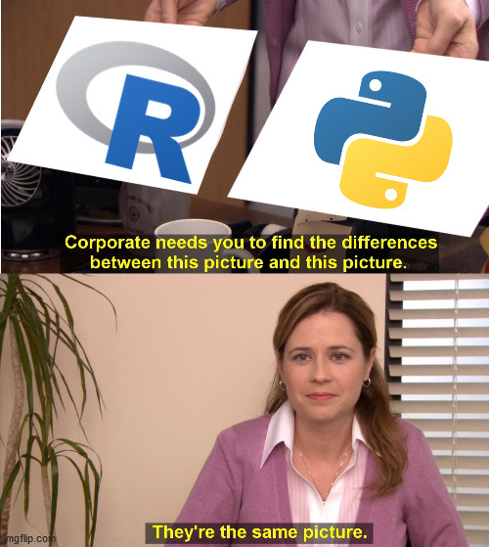
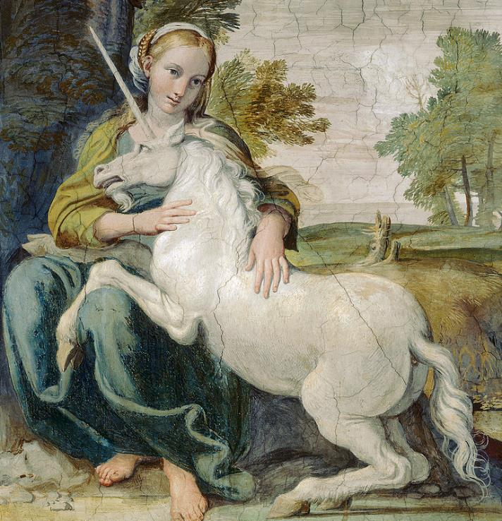
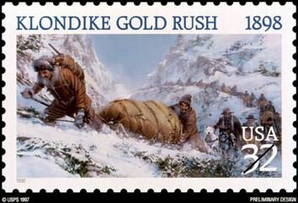
Python or R?
OK, wise guy, how would you have done it?
What courses should I take?
Is going back to school or a “bootcamp” worth it?
FREE💻SPACE
What about “low-code” & BI tools?
What should I read first and why is it “Moby Dick”?
But I’m a data scientist!
What tools do I need?

Slide 80
Further learning: some places to start
MIT OCW 6.0001: Introduction to Computer Science and Programming in Python (https://ocw.mit.edu/courses/electrical-engineering-and-computer-science/6-0001-introduction-to-computer-science-and-programming-in-python-fall-2016/) [⭐⭐]
MIT OCW 6.0002: Introduction to Computational Thinking and Data Science (https://ocw.mit.edu/courses/electrical-engineering-and-computer-science/6-0002-introduction-to-computational-thinking-and-data-science-fall-2016/) [⭐⭐⭐]
Harvard CS50: Introduction to Computer Science (https://www.edx.org/course/cs50s-introduction-to-computer-science) [⭐⭐]
Python for Everybody (https://www.py4e.com/) [⭐]

Slide 81
Bibliography of self-plagiarism
“data science without the hype” (https://terminusdatascience.com/talks/data-science-half-hour)
“A Dialogue” (https://usethe.computer/posts/17-a-dialogue.html)
“Dashboard Confessional” (https://usethe.computer/posts/11-dashboard-confessional.html)
“Why Are Data Scientists Switching from R to Python?” (https://usethe.computer/posts/9-why-are-data-scientists-switching-from-R-to-python.html)
“Typing ‘group by’, Revisited” (https://usethe.computer/posts/13-typing-groupby-revisited.html)
“Found in Translation: Domain-Specific Languages for Simple, Composable Systems” (https://github.com/derrickturk/dsl-talk)

Slide 82
Selected readings
“A Small Matter of Programming”, by Bonnie A. Nardi
“Teach Yourself Programming in Ten Years”, by Peter Norvig (https://www.norvig.com/21-days.html)
“Simple Made Easy”, by Rich Hickey (https://www.infoq.com/presentations/Simple-Made-Easy/)
“Everyone Should Program, or Programming is Hard? Both!”, by Mark Chu-Carroll (http://www.goodmath.org/blog/2012/10/05/everyone-should-program-or-programming-is-hard-both/)
“A Rocket to Nowhere”, by Maciej Cegłowski (https://idlewords.com/2005/08/a_rocket_to_nowhere.htm)
Crafting Interpreters, by Bob Nystrom (http://www.craftinginterpreters.com/)

Slide 83
DSL Implementation Notes
I think that I shall never see / some code as lovely as a tree
From the full version of “Found in Translation” (excerpted as Case Study III)

Slide 84
Functional(ish) Programming for Languages
We’re going to end up constructing recursive structures (ASTs) and manipulating/rewriting/folding/reducing them
This is a great place to apply some key ideas from functional programming (and specifically, from ML-inspired languages):
Static type checking with inference
Algebraic data types
Pattern matching
Higher-order functions
Immutability*

Slide 85
ADTs, Pattern Matching, and Recursion
Expression AST and Evaluator
Haskell
Expression AST and Evaluator
C#
data Expr = Const Int
| Plus Expr Expr
| Sub Expr Expr
| Mul Expr Expr
| Div Expr Expr
eval :: Expr -> Int
eval (Const n) = n
eval (Plus e1 e2) = (eval e1) + (eval e2)
eval (Sub e1 e2) = (eval e1) - (eval e2)
eval (Mul e1 e2) = (eval e1) * (eval e2)
eval (Div e1 e2) = (eval e1) `div` (eval e2)
main :: IO ()
main = let e = Mul (Const 3) (Plus (Const 5) (Const 2)) in
putStrLn $ show $ eval e
abstract class Expr {
public abstract int Eval();
public class Const : Expr {
public int Val;
public override int Eval() => Val;
}
public class Plus : Expr {
public Expr Lhs;
public Expr Rhs;
public override int Eval() => Lhs.Eval() + Rhs.Eval();
}
public class Sub : Expr {
public Expr Lhs;
public Expr Rhs;
public override int Eval() => Lhs.Eval() - Rhs.Eval();
}
public class Mul : Expr {
public Expr Lhs;
public Expr Rhs;
public override int Eval() => Lhs.Eval() * Rhs.Eval();
}
public class Div : Expr {
public Expr Lhs;
public Expr Rhs;
public override int Eval() => Lhs.Eval() / Rhs.Eval();
}
}
class ExprEvaluator {
public static void Main()
{
var expr = new Expr.Mul {
Lhs = new Expr.Const { Val = 3 },
Rhs = new Expr.Plus {
Lhs = new Expr.Const { Val = 5 },
Rhs = new Expr.Const { Val = 2 },
},
};
System.Console.WriteLine(expr.Eval());
}
}

Slide 86
Obligatory Rust Pitch
pub enum Expr {
Const(i32),
Plus(Box<Expr>, Box<Expr>),
Sub(Box<Expr>, Box<Expr>),
Mul(Box<Expr>, Box<Expr>),
Div(Box<Expr>, Box<Expr>),
}
impl Expr {
pub fn eval(&self) -> i32 {
match *self {
Expr::Const(n) => n,
Expr::Plus(ref e1, ref e2) => e1.eval() + e2.eval(),
Expr::Sub(ref e1, ref e2) => e1.eval() + e2.eval(),
Expr::Mul(ref e1, ref e2) => e1.eval() * e2.eval(),
Expr::Div(ref e1, ref e2) => e1.eval() / e2.eval(),
}
}
}

Slide 87
Parsing: Growing Trees from Text
Parsing is “easy” (we stand on the shoulders of giants)…
…for correct programs
Providing good errors for incorrect programs is much harder
Parser combinators are great: build up parsers from atomic components
Look for parser combinator libraries that provide a “cut” operator… or build one yourself
constExpr = (Const . fromInteger) <$> integer
plusExpr = parens (do
lexeme $ char '+'
lhs <- lexeme expr
rhs <- lexeme expr
return (Plus lhs rhs))
…
expr = constExpr
<|> try plusExpr
<|> try subExpr
<|> try mulExpr
<|> try divExpr
parseExpr :: String -> Either ParseError Expr
parseExpr = parse expr ""
main :: IO ()
main = case parseExpr "(* 3 (+ 5 2))" of
Left err -> putStrLn $ show $ err
Right e -> putStrLn $ show $ eval e

Slide 88
Evaluation: Transform and Fold
We have a range of evaluation strategies, from “interpretation” to “compilation”
Interpretation = traverse/fold final AST to execute/evaluate final program; heavier runtime
Compilation = emit some executable structure/format from final AST; lighter runtime
50 shades of grey: bytecode interpreters, virtual machines, JIT compilers…
For APML, we fold the AST to evaluate expressions on each incoming data item (interpretation) with some initial setup

Slide 89
Object-oriented Language Survival Tips
The Visitor Pattern is your friend: decouple traversal logic from node-specific processing
Encode AST recursive types as abstract classes; leaf types as concrete classes
Don’t worry about “encapsulation” (properties/getters/setters etc.); AST types are generally immutable* “dumb data”

Slide 90
Dynamic Typing Survival Tips
As above, but…
☹
Lean heavily on metaprogramming and interactivity

Slide 91
Dynamic Typing Survival Tips
class Const:
def __init__(self, val):
self.val = val
def eval(self):
return self.val
def BinOp(fn):
class BinOpClass:
def __init__(self, lhs, rhs):
self.lhs = lhs
self.rhs = rhs
def eval(self):
return fn(self.lhs.eval(), self.rhs.eval())
return BinOpClass
Plus = BinOp(int.__add__)
Sub = BinOp(int.__sub__)
Mul = BinOp(int.__mul__)
Div = BinOp(int.__floordiv__)
…
# some assembly required
def expr(input):
return alt(
fmap(Const, token(integer)), # const, or
fmap(lambda xs: Plus(xs[1], xs[2]),
form(chain(token(char('+')), expr, expr))),
fmap(lambda xs: Sub(xs[1], xs[2]),
form(chain(token(char('-')), expr, expr))),
fmap(lambda xs: Mul(xs[1], xs[2]),
form(chain(token(char('*')), expr, expr))),
fmap(lambda xs: Div(xs[1], xs[2]),
form(chain(token(char('/')), expr, expr))),
)(input)
def main(argv):
source_expr = '(* 3 (+ 5 2))'
(_, e) = expr(source_expr)
if e is None:
print('Invalid expression.', file=sys.stderr)
return 0
print('{} = {}'.format(source_expr, e.eval()))

Slide 92
Parser Combinators
Parsec, for Haskell (https://hackage.haskell.org/package/parsec)
Sprache, for C# (https://github.com/sprache/Sprache)
nom, for Rust (https://github.com/Geal/nom)
“Monadic Parsing in Haskell” (http://eprints.nottingham.ac.uk/223/1/pearl.pdf)

Slide 93
Programming Pragmatics
Less code, more advice
From an SPE YP webinar series on programming for engineers with Excel VBA

Slide 94
Version Control
version control system: software for managing revisions of tracked files (source code, documentation, final artifacts…), possibly by multiple users, allowing for:
auditing history
reverting changes
merging contributions by multiple users
branching: managing parallel revision histories with a common ancestor (e.g. “experimental features branch”, “stable release branch”)

Slide 95
Version Control
I use git: it’s distributed (no central repository required), fast, ubiquitous, and has good integration with many other tools.
It’s not the easiest learning curve in the world (although there are plenty of GUI wrappers, tutorials, etc.)
Others include Subversion (centralized, branching is hard), CVS (ancient, gross), mercurial (another distributed VCS), Microsoft TFS (integrates with Microsoft world).

Slide 96
Text Editors & IDEs
Some programmers like to use integrated development environments (IDEs), which combine:
text editing
compiler/interpreter/debugger integration
language-specific editing/refactoring tools
Others prefer to learn one text editor and use it to edit code in many languages, in conjunction with separate compilers, interpreters, etc.

Slide 97
Text Editors & IDEs
My take: either way is fine, but either way you’re going to want some basic features out of your editor:
syntax highlighting
regular expression (pattern-based) search and replace
go-to-definition/go-to-use for selected words
multiple-file management

Slide 98
Other Languages
VBA is a condescending, under-designed, overcomplicated dumpster fire of a language…
(… I had more here.)
If I could hit a button and make it disappear tomorrow, I would do it without the slightest hesitation.

Slide 99
Other Languages
But that’s the superficial stuff! Here’s what I really miss, in no particular order:
higher-order functions
structural polymorphism (generics, templates, “duck types”, …)
a real standard library, with:
associative arrays (dictionaries, maps, …)
a sort function (!)
various mathematical functions
a type system that can make up its mind (and either actually enforce useful invariants, or get out of my way)
a non-broken compiler (!)
a usable error handling system or convention

